Slide 1
NYCHA Voter Turnout: Overview
8.2%
AVG
0.9%
MIN
TA Elections, 2021 – 2022
43%
AVG
13%
MIN
2016, 2020 Presidential Elections
21%
AVG
0.0%
MIN
2017, 2018, 2021 Municipal/Gubernatorial Elections
15%
AVG
0.0%
MIN
Major Primary Elections, 2016 – 2021

Slide 2
TA Election Turnout: Overview
CCOP District | Average (2021-2022) | Minimum (2021-2022)
Bronx | 7.2% | 2.0%
Bronx North | 9.1% | 2.4%
Bronx South | 4.9% | 2.0%
Brooklyn | 7.0% | 1.4%
Brooklyn East | 8.5% | 1.4%
Brooklyn South | 4.4% | 1.4%
Brooklyn West | 8.8% | 1.7%
Manhattan | 10.0% | 0.9%
Manhattan North | 4.0% | 0.9%
Manhattan South | 13.8% | 2.6%
Queens | 7.8% | 1.1%
Staten Island | 4.4% | 4.4%
Highest Average Turnout: 13.8% (Manhattan South)
Lowest Average Turnout: 4.0% (Manhattan North)

Slide 3
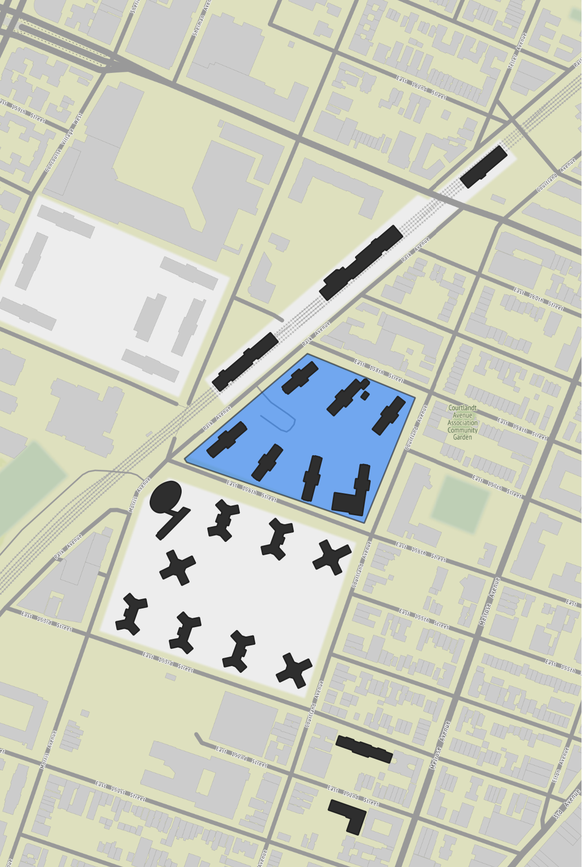
Jackson Houses
T.A. President: Daniel Barber
Overview
Official Adult Pop. 1,467
Registered Voters 1,832
Highest Turnout Election 2016 Gen.
Lowest Turnout Election 2017 Prim.
Voter Turnout in Recent Elections
Election | General | Primary
2021 (Municipal) | 10.3% | 9.1%
2020 (Presidential) | 30.2% | 12.9%
2018 (Gubernatorial) | 25.8% | 12.5%
2017 (Municipal) | 10.0% | 6.3%
2016 (Presidential) | 37.6% | 14.6%

Slide 4
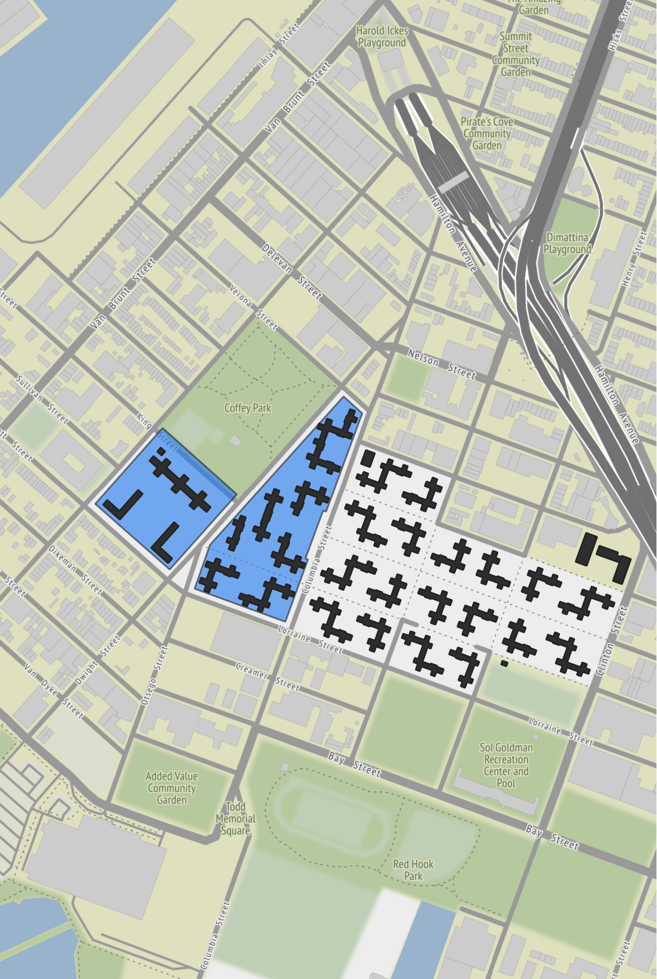
Red Hook West
T.A. President: Karen Blondel
Overview
Official Adult Pop. 2,171
Registered Voters 2,461
Highest Turnout Election 2016 Gen.
Lowest Turnout Election 2017 Prim.
Voter Turnout in Recent Elections
Election | General | Primary
2021 (Municipal) | 12.8% | 12.8%
2020 (Presidential) | 42.7% | 12.6%
2018 (Gubernatorial) | 28.4% | 14.5%
2017 (Municipal) | 11.3% | 1.9%
2016 (Presidential) | 42.1% | 14.3%

Slide 5
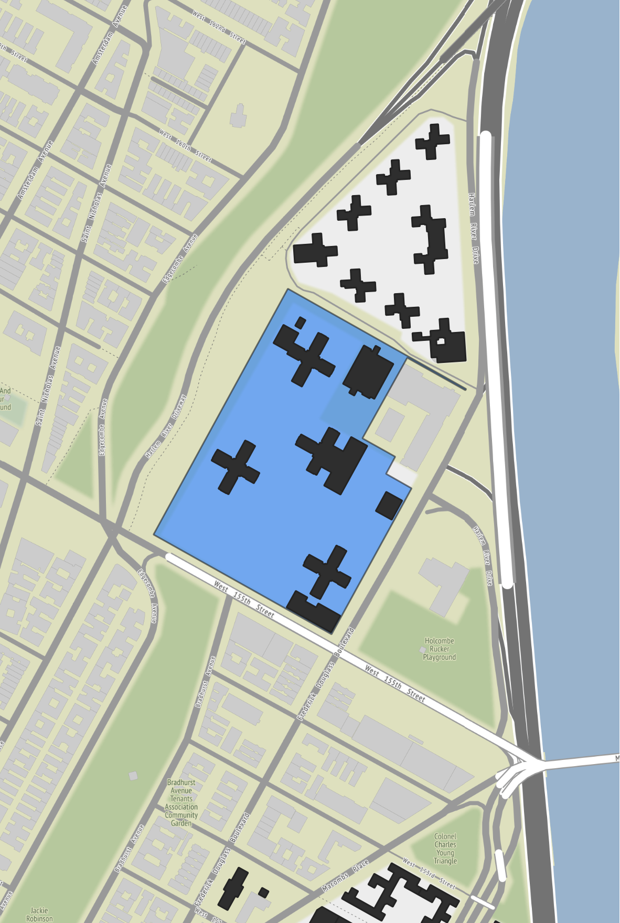
Polo Grounds Towers
T.A. President: Serena Chandler
Overview
Official Adult Pop. 2,711
Registered Voters 2,922
Highest Turnout Election 2016 Gen.
Lowest Turnout Election 2017 Prim.
Voter Turnout in Recent Elections
Election | General | Primary
2021 (Municipal) | 15.7% | 15.0%
2020 (Presidential) | 38.7% | 13.3%
2018 (Gubernatorial) | 31.7% | 17.6%
2017 (Municipal) | 10.9% | 9.7%
2016 (Presidential) | 46.8% | 19.8%

Slide 6
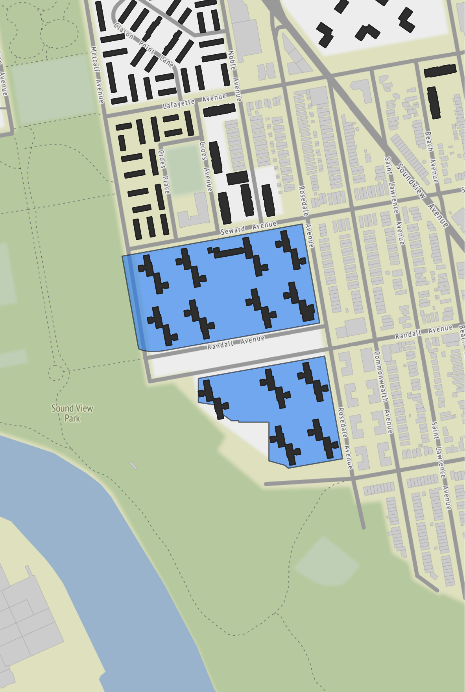
Soundview Houses
T.A. President: Anne Johnson
Overview
Official Adult Pop. 2,021
Registered Voters 2,351
Highest Turnout Election 2016 Gen.
Lowest Turnout Election 2017 Gen.
Voter Turnout in Recent Elections
Election | General | Primary
2021 (Municipal) | 11.9% | 11.9%
2020 (Presidential) | 36.0% | 11.7%
2018 (Gubernatorial) | 29.0% | 15.7%
2017 (Municipal) | 8.2% | 9.3%
2016 (Presidential) | 43.0% | 15.7%

Slide 7
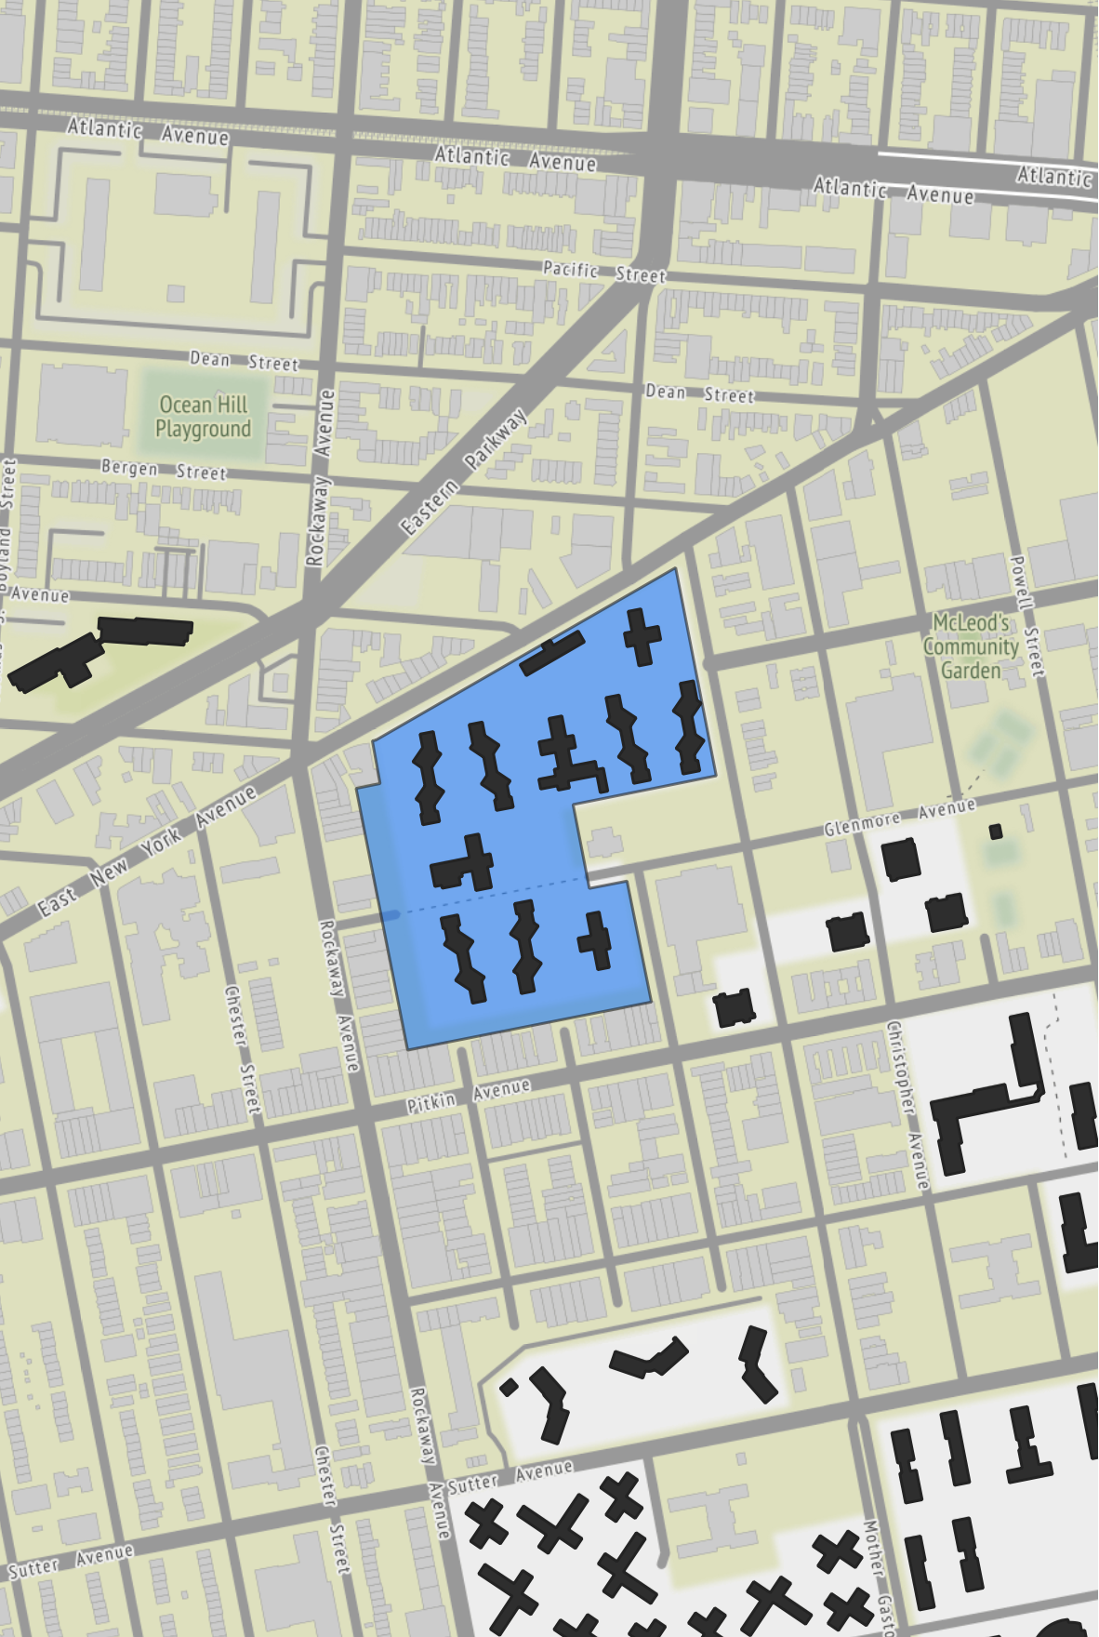
Howard Houses
T.A. President: Naomi Johnson
Overview
Official Adult Pop. 1,219
Registered Voters 1,421
Highest Turnout Election 2020 Gen.
Lowest Turnout Election 2017 Prim.*
Voter Turnout in Recent Elections
Election | General | Primary
2021 (Municipal) | 10.0% | 11.3%
2020 (Presidential) | 41.3% | 7.7%
2018 (Gubernatorial) | 28.1% | 13.1%
2017 (Municipal) | 12.8% | 0.8%*
2016 (Presidential) | 41.0% | 14.6%
*Outlier. Possible BOE administrative error.

Slide 8
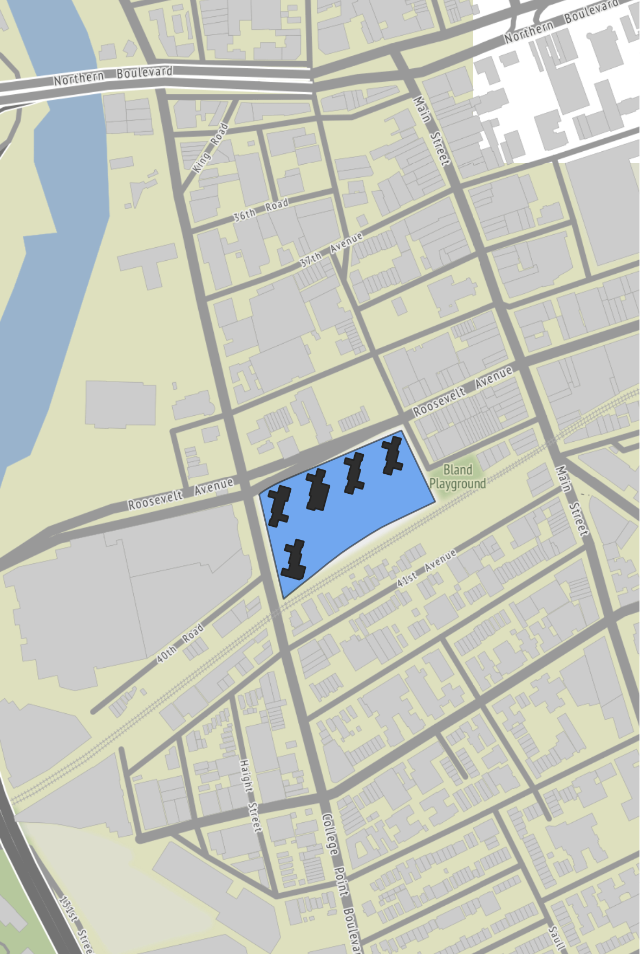
Bland Houses
T.A. President: Bridget Marachilian
Overview
Official Adult Pop. 644
Registered Voters 643
Highest Turnout Election 2016 Gen.
Lowest Turnout Election 2017 Gen.*
Voter Turnout in Recent Elections
Election | General | Primary
2021 (Municipal) | 19.9% | 20.0%
2020 (Presidential) | 49.1% | 18.4%
2018 (Gubernatorial) | 35.8% | 21.0%
2017 (Municipal) | 0.6%* | 17.9%
2016 (Presidential) | 50.9% | 27.2%
*Outlier. Possible BOE administrative error.

Slide 9
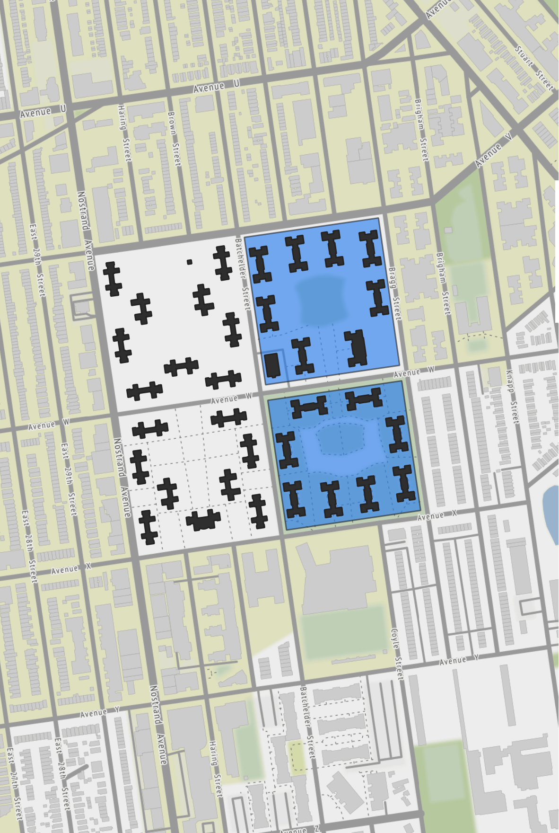
Nostrand Houses
T.A. President: Barbara McFadden
Overview
Official Adult Pop. 1,636
Registered Voters 1,751
Highest Turnout Election 2016 Gen.
Lowest Turnout Election 2017 Prim.
Voter Turnout in Recent Elections
Election | General | Primary
2021 (Municipal) | 13.5% | 11.3%
2020 (Presidential) | 37.1% | 10.8%
2018 (Gubernatorial) | 30.1% | 12.1%
2017 (Municipal) | 14.0% | 5.5%
2016 (Presidential) | 41.6% | 13.6%

Slide 10
Riis Houses
T.A. President: Daphne Williams
Overview
Official Adult Pop. 3,009
Registered Voters 2,698
Highest Turnout Election 2020 Gen.
Lowest Turnout Election 2017 Prim.
Voter Turnout in Recent Elections
Election | General | Primary
2021 (Municipal) | 14.6% | 13.5%
2020 (Presidential) | 40.9% | 11.1%
2018 (Gubernatorial) | 28.2% | 16.1%
2017 (Municipal) | 13.9% | 10.6%
2016 (Presidential) | 40.1% | 16.8%

Slide 11
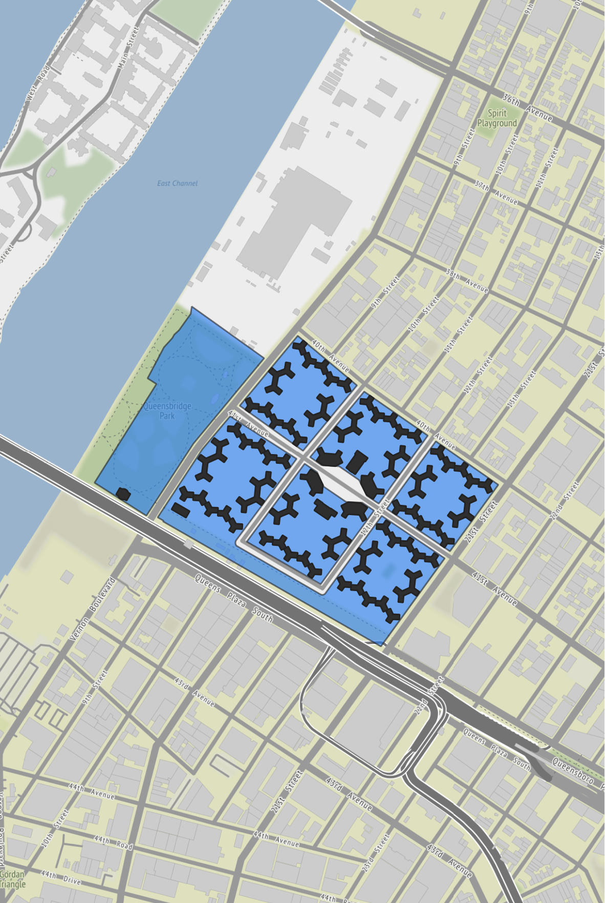
Queensbridge Houses
T.A. President: Corinne Haynes
Overview
Official Adult Pop. 4,609
Registered Voters 4,728
Highest Turnout Election 2016 Gen.
Lowest Turnout Election 2017 Prim.
Voter Turnout in Recent Elections
Election | General | Primary
2021 (Municipal) | 18.7% | 18.9%
2020 (Presidential) | 47.0% | 17.3%
2018 (Gubernatorial) | 17.2% | 21.8%
2017 (Municipal) | 22.1% | 10.4%
2016 (Presidential) | 51.2% | 21.8%

Slide 12
Minimum thresholds in other elections
Election | Method of Winning
Presidential Elections | No minimum threshold
Congressional Elections | No minimum threshold
NY State Elections | No minimum threshold
NYC Elections | No minimum threshold
TA Elections | No minimum threshold
Mitchel-Lama Elections | No minimum threshold

Slide 13
Potential Components for Consideration
Minimum Threshold
Additional Triggers
Minimum Engagement
Minimum of 8.2% of tenants of record must vote
Minimum of 8.2% of tenants of record must vote
Best efforts must be made such that 30% of tenants of record vote; if this threshold is not reached, additional analysis and engagement is required
Minimum of 8.2% of tenants of record must vote
Best efforts must be made such that 30% of tenants of record vote; if this threshold is not reached, additional analysis and engagement is required
There must be a minimum amount of engagement for the vote to be considered valid
Example
Other factors to consider
Voter fatigue, in case of a re-do vote
Depth of engagement at the properties
Proper notification and education before vote

Slide 14
How does an option win?
Election | Method of Winning
Presidential Elections | Candidate with most votes wins
Congressional Elections | Candidate with most votes wins
NY State Elections | Candidate with most votes wins
NYC Elections | Ranked Choice Voting
TA Elections | Candidate with most votes wins

